Slide 1
Analysis of Motor Collision and Crashes in NYC
By Oluwatoba Oyekanmi

Slide 2
Problem
Given that Motor vehicle accidents are the leading cause of injury related to death for New York residents.
This projects aims to accomplish an exploratory analysis on NYC Motor Collisions and Crashes and predicts the number of accidents per day in each borough.

Slide 3
Datasets
Data used in analysis contained 8925 rows and 18 features. The key features are:
Crash dates and time
Location: borough, streetname, latitude, longitude, zipcode
Vehicle type
Contributing factor
Number of casualties and fatalities

Slide 4
Data Wrangling
Some of the procedures carried out are as follows:
Irrelevant columns were dropped
Features with over 50% null values were dropped
Missing values were obtained using other features: borough and zipcodes null values obtained through longitude and latitude
Date and time features were converted to datetime types

Slide 5
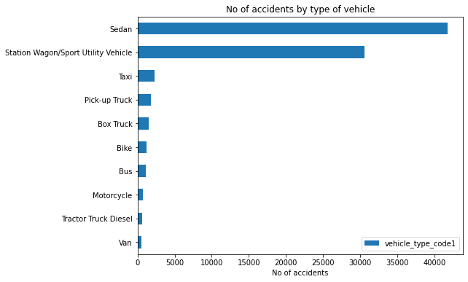
Exploratory Data Analysis
Majority of vehicles involved in an accidents were Sedans. It makes sense since inexperienced and newbie drivers are more likely to drive sedans

Slide 6
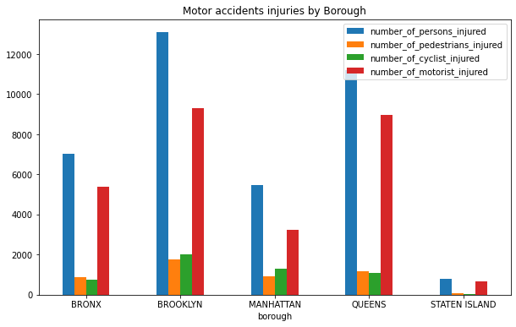
Brooklyn has the highest number of non-fatal accidents 13089
Staten Island had the lowest number of accidents across all kinds of accidents.

Slide 7
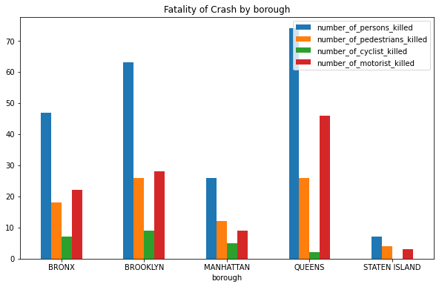
Queens has the most fatal accidents.
Staten Island has the least fatalities overall

Slide 8
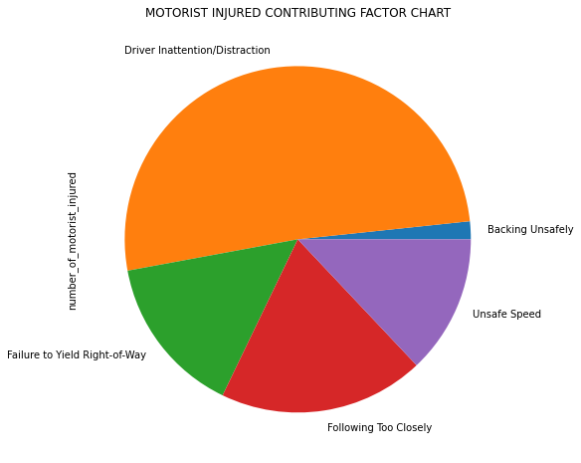
The chart reveals the top 5 causes of accidents
Observe majority of crashes is caused by Driver Inattention/Distraction which could vary from cell phone use, eating, GPS, etc

Slide 9
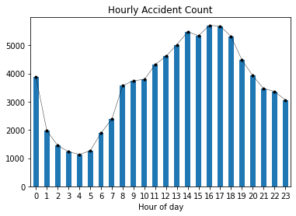
Also, observe that crashes trends upward from 8am and downwards after 8pm.

Slide 10
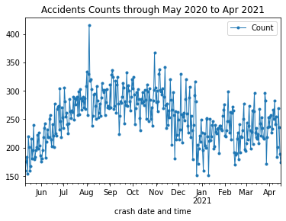
Observe that accident counts spiked between May and November. These months are summer periods and people are more likely to drive carelessly in this season.

Slide 11
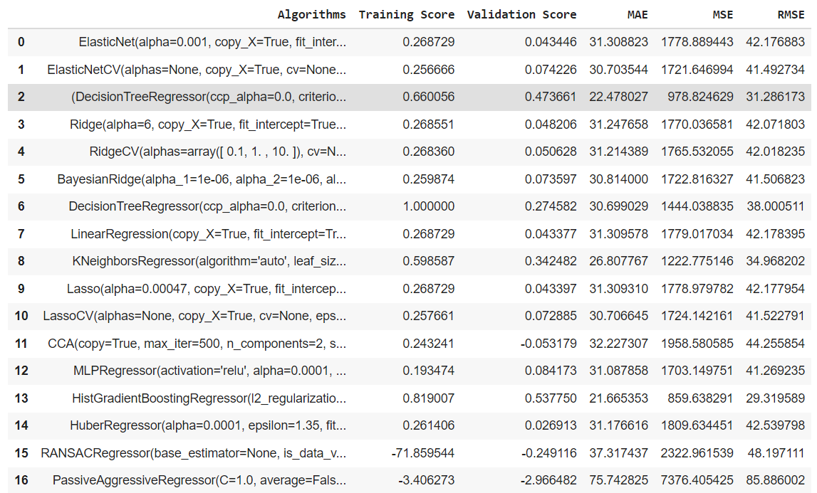
Modelling
Multiple estimators were tried but the best performing(top 3) are:
RandomForest Regressor
GradientBooding Regressor
HistGradient Boosting Regressor

Slide 12
Key Takeaway
Random Forest Regressor performed best among all models attempted with an root mean square error of 28.73 and R^2 of 0.56
The mean of accidents in NYC is 151. Thus our model’s margin of error is 11.37%

Slide 13
Future Works
This work could further extended with the following to solve the solving:
Analysis and Development of Hospitals and Treatments Centres around high severity accident hotspot in NYC.
Analysis and predicting factors affecting accidents severity in NYC
Exploratory Analysis of weather and climate effect on accidents in NYC

Slide 14
THANK YOU

